Slide 1
Robust Programs and Exception Handling
CS221 – February 11, 2009

Slide 2
Introduction
How to contact me
  Jason Taylor
  tlaloc75@gmail.com
  After classes in this room or in EPS lobby
Who am I?
  MSU CS/Physics Grad in ’97
  6 years Microsoft
    Test lead, development manager, architect
  6 years Security Innovation
    Manage product development and professional services
  Link to bio on announcements page

Slide 3
Announcements
Future classes and readings on the sessions page
Future labs on the labs page
Pages will be updated after each class
Quizzes -> Midterm + Final
Grading:
  40% exams
  50% graded assignments and quizzes you’ve already taken
  10% professional points
Midterm is March 11th during class
Final is May 7th from 6:00-7:50 pm in this room

Slide 4
Queue Recap
Key Points
  FIFO data structure
  Can be implemented with:
    ArrayList, Singly Linked List, Doubly Linked List, Circular Linked List, etc
  Java run time has a variety of queue implementations to choose from:
    Queue, priority queue, etc

Slide 5
Queue Recap
The important methods on a queue interface:
  Enqueue (or add)
  Dequeue (or remove)
  MakeEmpty (or clear)
  IsEmpty
  Peek
You can use generics to improve reusability of your queue

Slide 6
Queue Recap
Converting to Generic
  All Node references changed to Node<E>
  Element changed from Int to E
  Class definition changed from Node to Node<E>
Why?
  Did John have to cast to (E) in Peek method?
  Does Java Queue have multiple overlapping methods (Add/Offer, Peek/Poll, etc)?
  Why did John pick a circular linked list?
  What tradeoffs should you consider when implementing an ADT like Queue?

Slide 7
Program Robustness
Robustness is:
  A system able to handle abnormal conditions gracefully
Robustness includes:
  Reliability as well as Security. Impacted by maintainability.
Fragility is:
  A system that works on your development machine but breaks in the real world!

Slide 8
Robustness
Why is it important?
  Customer impact and reduced satisfaction
  Development cost to your business
  Bottom line: Your job security

Slide 9
Why does it matter?
Sapphire Worm (2003)
  Type: Implementation Failure
  74,855 hosts in 30 minutes
  Doubled in size every 8.5 minutes
  90% of the vulnerable target machines were compromised in 10 minutes
  Cause: Buffer Overflow in SQLServer

Slide 10
Why does it matter?
FAA Advanced Automation System
  Type: Design Failure
  $2.5 billion contract -> $7.5 billion cost
  1.5 MLOC, 3k known bugs
  Project was never finished
  Hundreds of careers at IBM were ruined
  Cause: Poorly thought out design, implementation complexity

Slide 11
Implementation Defects
Syntax Errors
  Equivalent to a typo or grammatical error
  Usually caught by the compiler
  Eclipse will notify you in real-time
Run-time Errors
  Errors that can only be detected during execution
  Depends on user input or dynamic variable values
  Usually results in an exception
Logic Errors
  The program looks correct but doesn’t operate according to specification
  Usually detected in testing
  If not detected, it will impact robustness in the field

Slide 12
Syntax Errors
Example 1:
    Node (E contents)
    {
    this.contents = Contents
    this.next = null
    }
Example 2:
    public boolean isEmpty()
    {
    if (first = last)
    {
    return true;
    }
    else
    {
    return false;
    }
    }

Slide 13
Runtime Errors
Example 1
    selection = Integer.parseInt(choice);
Example 2
    node.getNext().getContents();
Example 3
    int[] arrayOfIntegers = new int[10];
    for (int i = 0; i <= 10; i++)
    {
    arrayOfIntegers[i] = i;
    }

Slide 14
Logic Errors
Example
  Enqueue adds to the end of the queue instead of the front
  IsEmpty returns true when queue is empty
  Peek removes an item from the queue
  Etc, etc….

Slide 15
Strategies for Robust Programs
Defensive programming
  Write code with failure conditions in mind
  Check your pre and post conditions
  Validate all input
  Understand and check your assumptions
Structured exception handling
  Catch exceptions to detect error conditions
  Throw exceptions to notify caller of error conditions
  Only catch an exception if you know how to handle it
  Only throw an exception if you cannot handle the error
Rigorous testing
  We’ll spend time talking about testing later

Slide 16
Structured Exception Handling
Old Style, notify the caller:
  Return value
  GetLastError()
  Out parameters
New Style, notify the caller:
  Throw an exception
Advantages:
  Separates error code from normal code
  Automatic propagation of errors up the call stack
  Differentiate errors by exception type
  Exceptions contain rich information for debugging

Slide 17
What is an Exception
An exception is an event that interrupts normal flow of the application
Signifies an exceptional event or error
Every Java exception is a class object
When you throw an exception you create a new instance of the class
  throw new NumberFormatException(“Details”);
Throw:
  Stops application execution
  Walks up the call stack looking for a matching catch block
  Terminates the process if no catch block is found

Slide 18
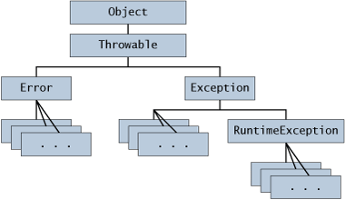
Java Exception Heirarchy
All exceptions derive from Exception which derives from Throwable.
You can use an existing Java exception or create your own.

Slide 19
Checked Exceptions
Represent recoverable errors
Must be caught somewhere in your application
If you call a method that throws a checked exception:
  Catch it
  Or use Throws to specify that it will be passed up the call stack

Slide 20
Unchecked Exceptions
Represent unrecoverable errors
Java doesn’t force you to catch them
If you don’t catch, it will result in program termination
Examples
  NumberFormatException
  NullPointerException

Slide 21
Creating your own exceptions
Use Java library exceptions, unless:
  There is no exception that matches closely enough
  You need to differentiate from exceptions thrown by methods you call
  You need to differentiate from other exceptions you throw
Don’t create unchecked exceptions unless:
  There is no way in which the calling code could recover

Slide 22
Throwing an Exception
Throw an exception if:
  You have detected an error condition
  You cannot handle it in the current method
  The error requires the current method to terminate execution
  The error should be handled higher in the call stack

Slide 23
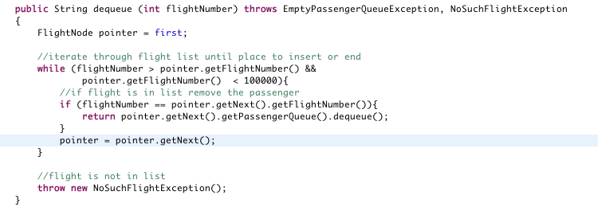
Throw Example

Slide 24
Throw Example
You can put details in the exception:
  throw new NoSuchFlightException(“That flight is empty”);
And recover it in the catch:
    catch (NoSuchFlightException ex)
    {
    System.out.println(ex.toString());
    }

Slide 25
Using Throws
You must use throws if:
  Your method throws a checked exception
  Your method calls a method that throws a checked exception and you do not catch it

Slide 26
Catching an Exception
Try/Catch/Finally
Try
  Enclose code that may throw an exception you want to catch
Catch
  Specify the type of exception you want to catch
  Catch in order from most specific to least
Finally
  Code that you want executed no matter what
  Usually cleanup code

Slide 27
Exception Ordering Example
try
{
//do something
}
catch(Exception ex)
{
//general exception handling
}
catch(NumberFormatException ex)
{
//specific exception handling for number format exceptions
}

Slide 28
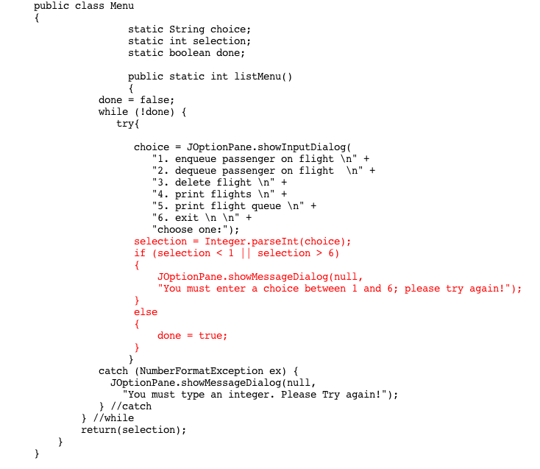
Exception Example

Slide 29
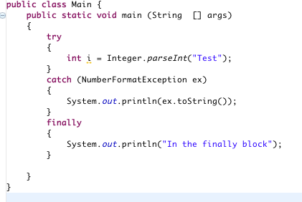
Finally Example

Slide 30
The Dark Side
Exception handling can be dangerous:
  Disclosure of sensitive information
  Fail to an insecure state
  Catching exceptions too broadly
  Return in a finally

Slide 31
Disclosure of Sensitive Information
Causes:
  Failure to handle exceptions
  Too much information in error messages
Internal exception information can be used to attack your application
  Stack information
  Database names and tables
  Etc
Especially dangerous with web applications
Protect yourself:
  Catch exceptions
  Provide user with friendly error messages but no internal application details

Slide 32
Fail to an Insecure State
Causes:
  You catch the exception but do nothing or fail to clean up properly
Your application may fail to unknown or insecure state
Result could be logic flaws or security vulnerabilities
Protect yourself:
  Use catch blocks to run code specific to the error
  Use finally blocks to clean up resources and return to a known good state

Slide 33
Catching Exceptions too Broadly
Causes:
  You catch high level Exceptions instead of specific exceptions
Your code will not be able to differentiate which error has occurred
Protect yourself:
  Catch and handle the specific exceptions that can be thrown by the methods you call

Slide 34
Return in a Finally
Causes:
  Adding a return statement within a try-finally block
The exception will get lost and never returned to the caller
Protect yourself:
  If you are using the try-finally construct, do not return from within the finally block

Slide 35
Exceptions - Key Points
Three types of errors: syntax, runtime, and logic
Exceptions are error conditions that should be handled by the caller
Checked vs. unchecked exceptions
Throw and Throws
Try/Catch/Finally
Be careful with exceptions

